Slide 1
Y-chromosome loss
(Updates and a PanCancer view)
Chris & Subhi
Notes:
SN 1- 4
CK 5-9
SN 9- 16
CK: Rest

Slide 2
Outline
Introduction : Chromosome Y loss in Prostate Cancer
Study overview
Chromosome Y loss across cancer types
Gene - pathway alterations associations with chromosome Y loss
Survival analysis
Somatic mosaicism
Notes:
Y-chromosome mosaicism, that basically refers to a state where several cells might have lost the Y-chromosome and others do not. Again: mosaicism is a state where not every cell shares the same DNA (extent, structure, sequence, etc.) anymore ~ intra-tumor heterogeneity is a good example. Where we have subpopulations within ‘the original’ cells.

Slide 3
Y chromosome loss (Prostate Cancer)
Introduction I
Generally: studies specifically concentrating on Y-chromosome loss in solid cancers are rare
MSK-IMPACT and MSK-WES recapture sequencing provide enough information to estimate CN changes at the Y-chromosome (MSY; not PAR1/2)
Continuous approximation of copy numbers provide means for comparison studies
Strong association between FGA and Y-chromosome loss
19.5% of prostate cancer samples have lost the Y-chromosome
Notes:
19.4% Y-chromosome loss in prostate cancer cohort (where both WES and IMPACT are available)

Slide 4
Study population - Overview
Methods: WES and TCGA data were simultaneously analysed; however, will not be discussed here
40,818 1sample/patient
validation cohort
22,250 females
957 WES samples (7.7%)
4,875 TCGA samples
data freeze 40K
18,351 male samples
failed QC metrics
12,405 IMPACT samples
analysis cohort

Slide 5
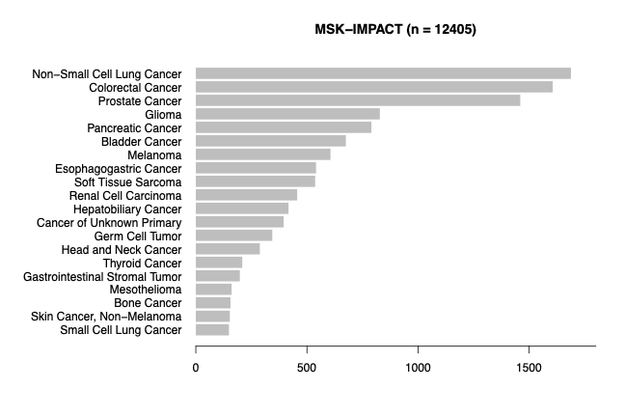
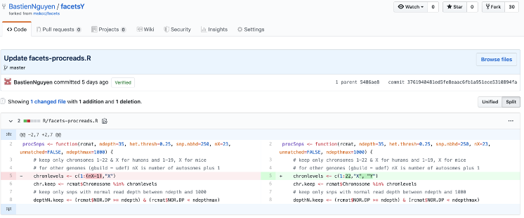
FacetsY is suitable for estimating Y-chromosome loss in solid cancer tissue
Strict data quality measures were applied

Slide 6
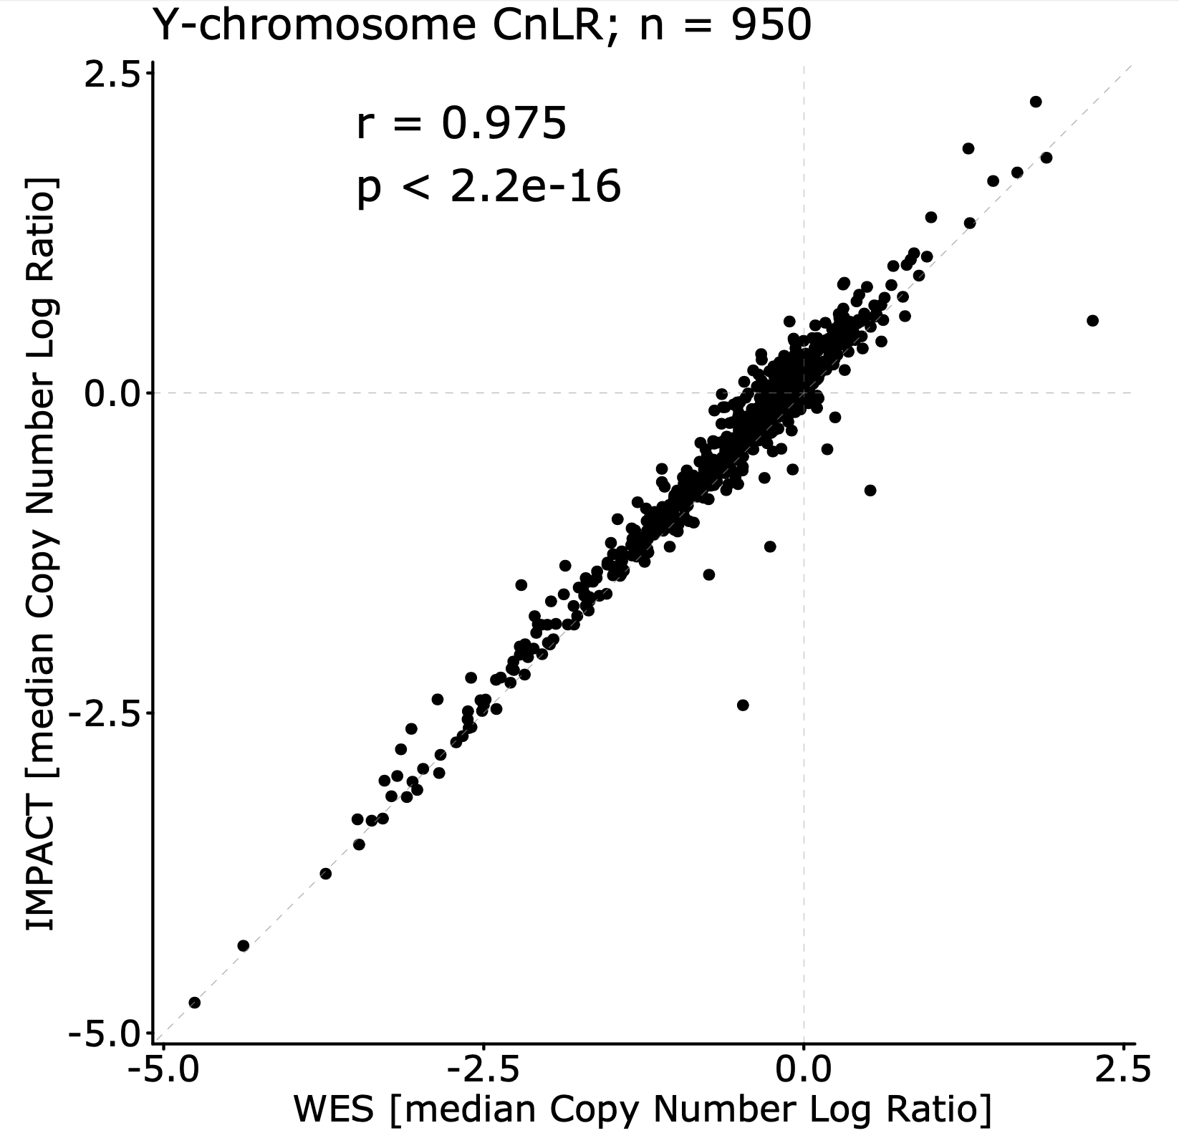
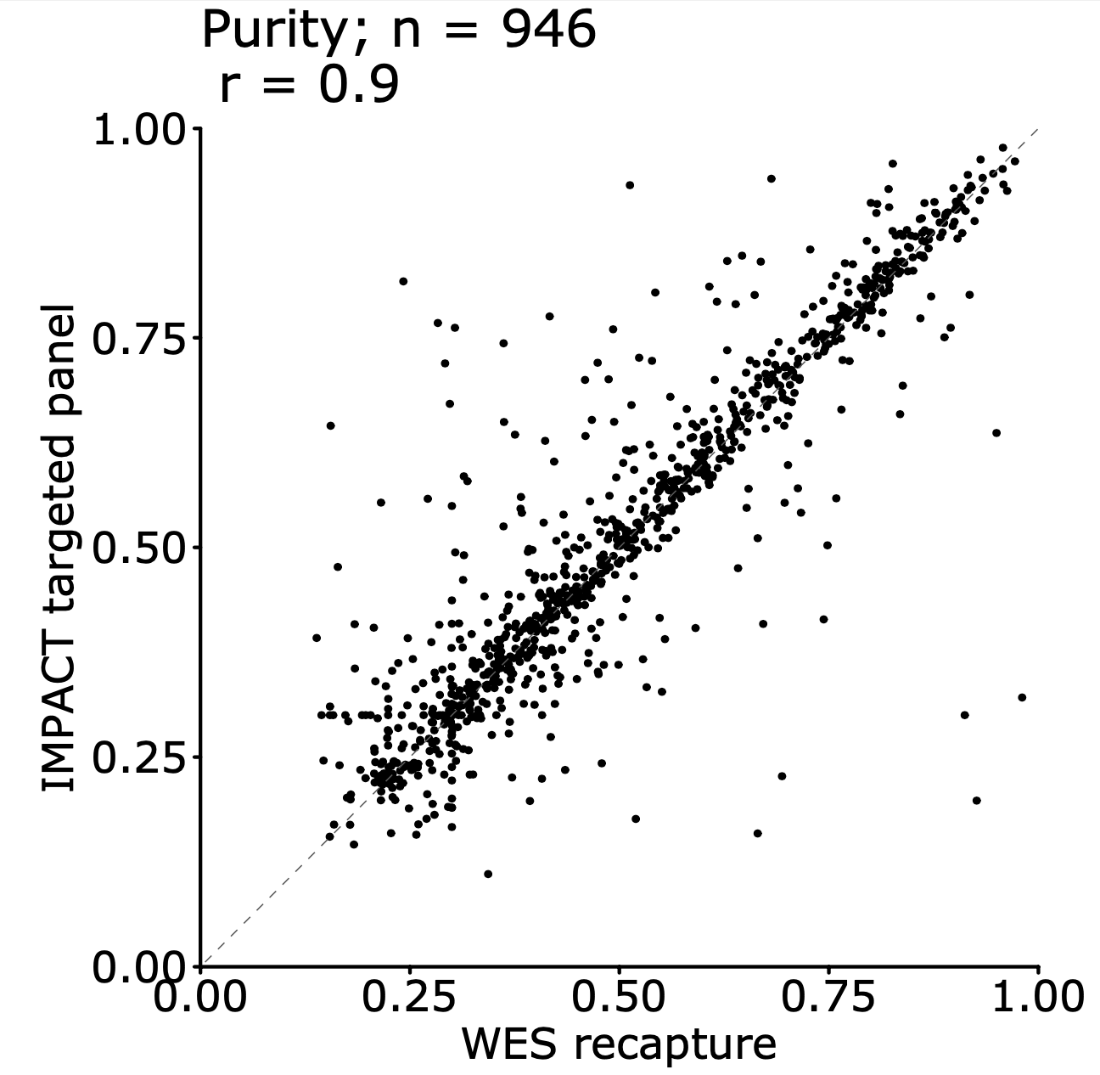
MSK-IMPACT data is a robust data source to study Y-chromosome loss
Results: FacetsY was independently validated with FISH data (organoid seq. Harisha)
parameter selection
What we learned from Prostate Cancer samples; Parameter selection is good

Slide 7
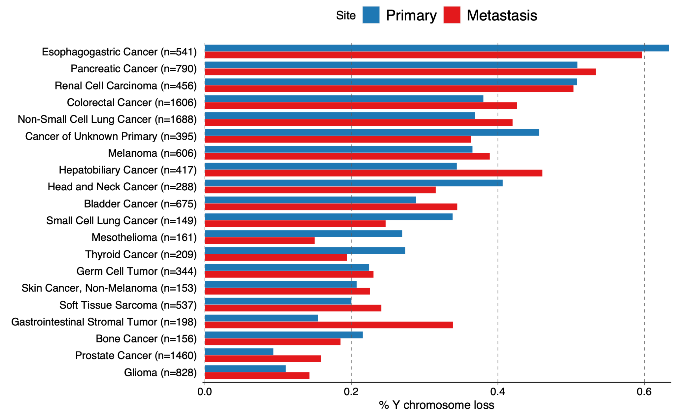
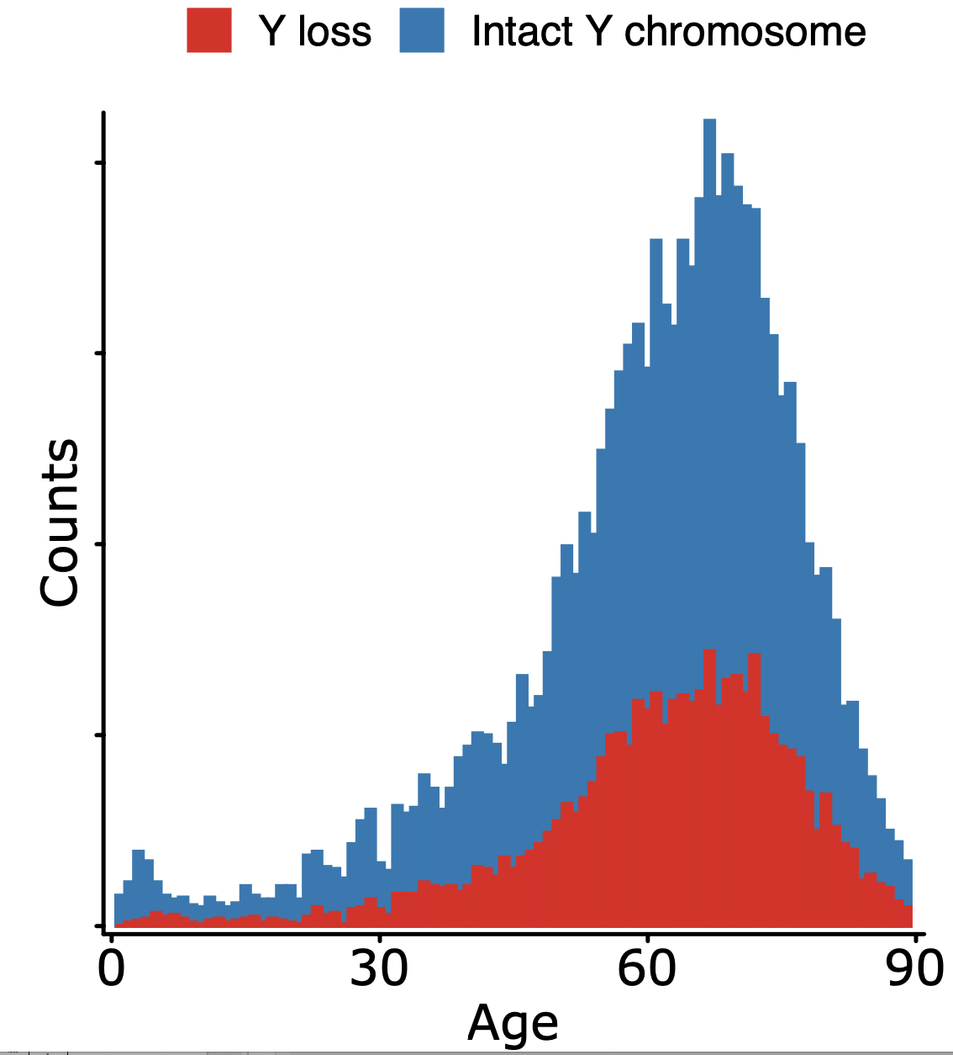
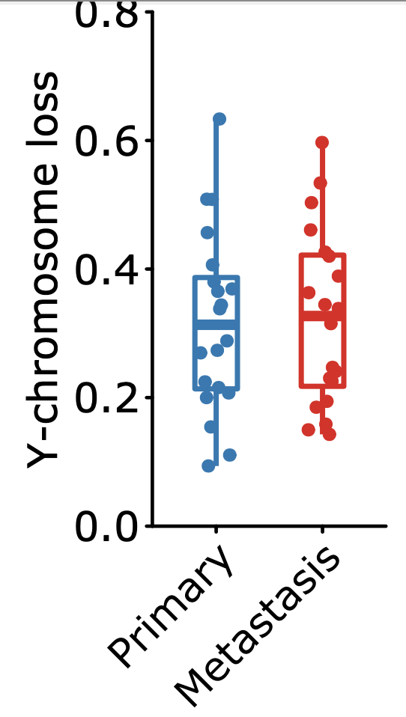
Y chromosome loss is cancer type dependent
Results: Y-chromosome loss is tumor site independent
p=0.9
~32% of MSK-IMPACT cancer samples suffer from Y-chromosome loss

Slide 8
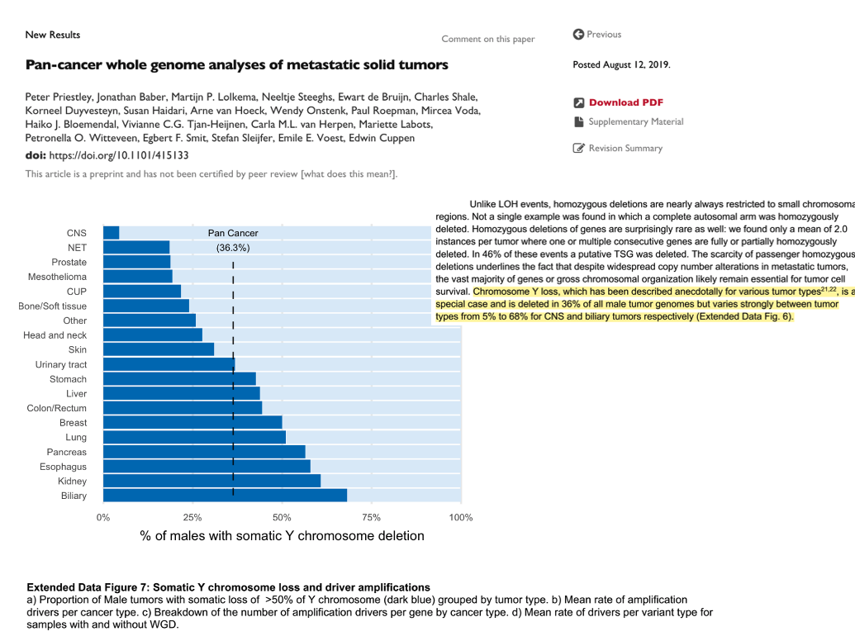
Y-chromosome loss is tumor site independent shown in a previously published cohort

Slide 9
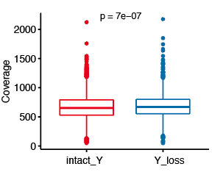
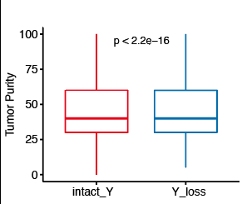
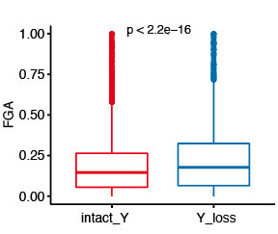
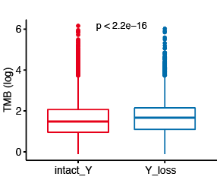
Y chromosome loss is associated with higher TMB, FGA

Slide 10
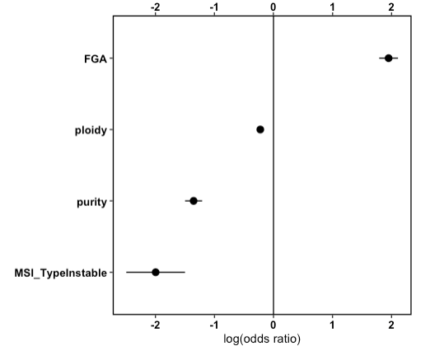
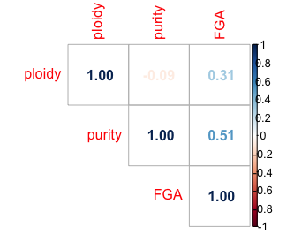
FGA and MSI Type will be included in survival and enrichment analysis
FGA and MSI show significant confounder effects
Correlation coefficient, p value < 2.2e-16
Logistic regression model on Y-chromosome loss
P < 0.001
Notes:
To adjust for any potential confounding factors in our sttaistical test we performed a simple logistic regression model to the clinical data we had
FGA and MSI show the most significant confounder effects. However ploidy and purity values obtained from facets is highly correlated (plot on right) with FGA. We use FGA and MSI
model1 = glm(Y_call ~ ., data = clinical_glm, family = binomial(link = 'logit'))

Slide 11
Methods
Identify ChrY loss differences in gene-level driver and pathway-level alterations
Combined mutations, copy number alterations, and fusions (oncogenic)
Minimum alteration frequency 3%
Pancancer & subtype-specific cohorts
Cancer Type
Pancancer
Multivariate logistic regression to account for potential confounders:
Sample Type
FGA and MSI Type
Model:
Cancer Type: Gene | pathway ~ ChrY call + Sample Type + FGA + MSI Type
Pancancer: Gene | pathway ~ ChrY call + Sample Type + FGA + MSI Type + Cancer Type
FDR < 0.05
Notes:
1. gene has at least 1 mutant and at least 1 wild type
2. gene has alteration frequency of >= 0.03
- The logit model is only run on genes that meet this criteria. If they do not meet it, the output will label this gene as "Not Tested"
- Adjusted p-value is done on the complete output using p.adjust and method FDR

Slide 12
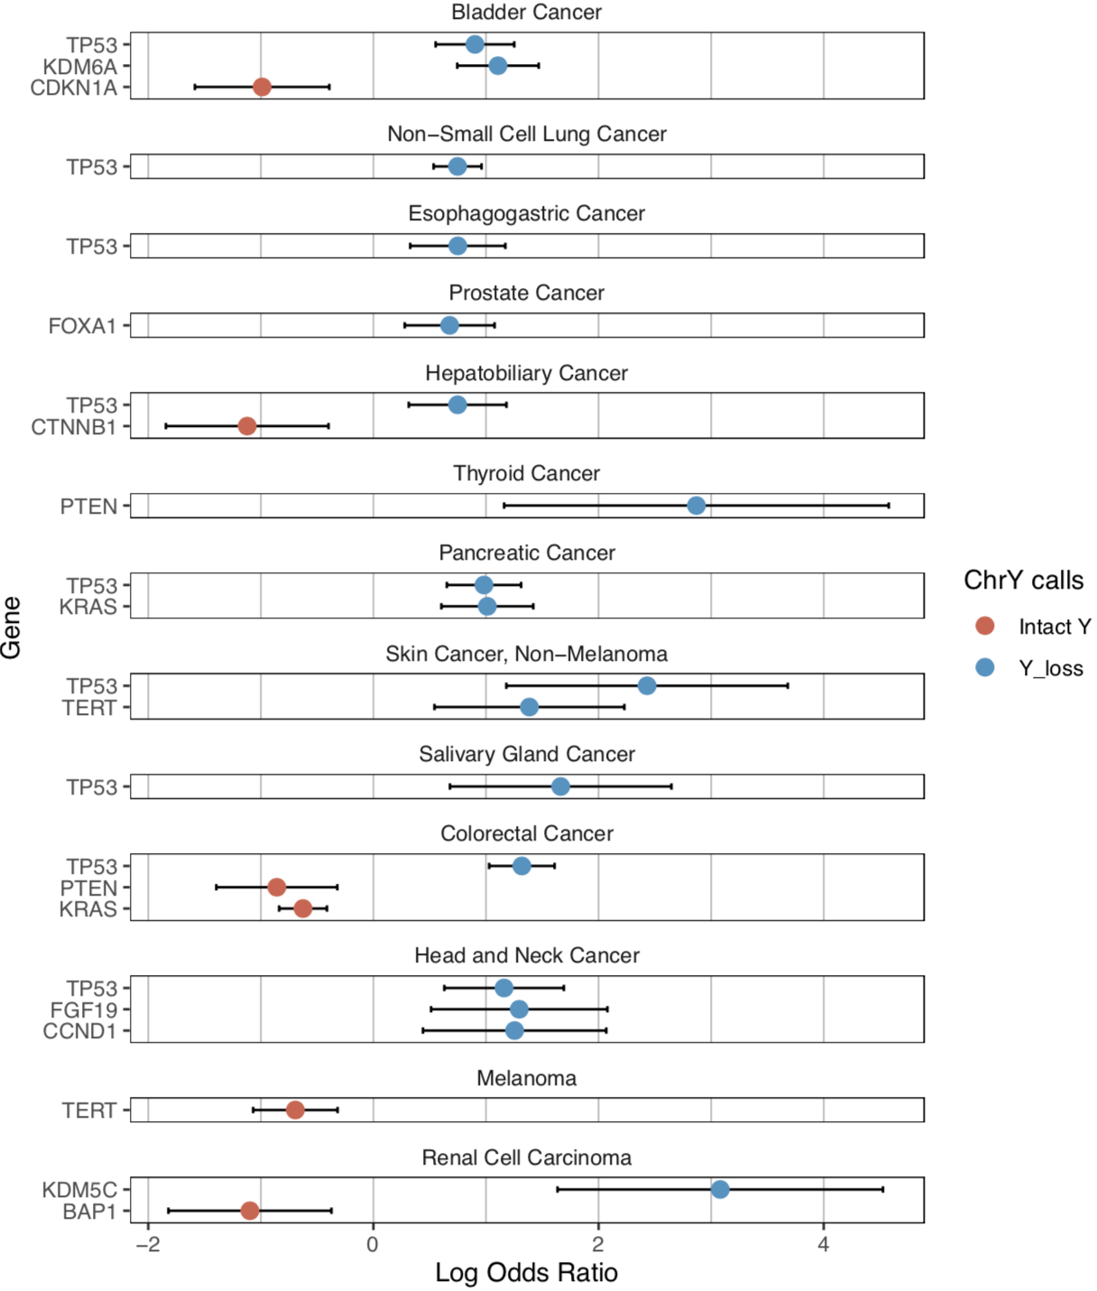
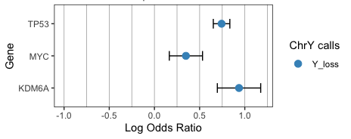
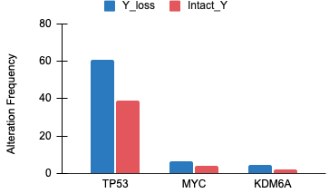
Cancer Type
Gene Level Differences
Enriched in Intact Y
Enriched in Y loss
Pancancer
Enriched in Intact Y
Enriched in Y loss
Model: Gene ~ ChrY call + Sample Type + FGA + MSI Type + Cancer Type
Model: Gene ~ ChrY call + Sample Type + FGA + MSI Type
Notes:
KDM6A is histone demethylase on X chromosome.
Frequency: loss | intact
TP53: 60 | 38
KDM6A: 4 | 2
MYC: 6 | 3

Slide 13
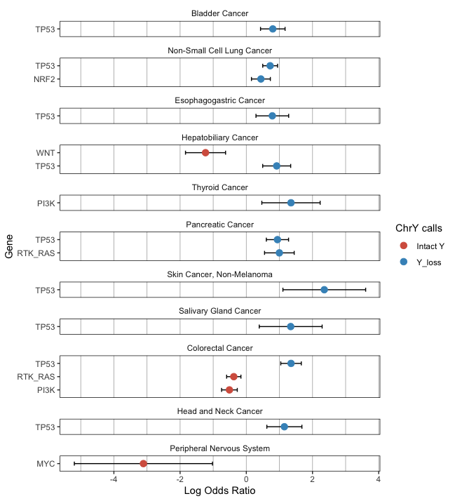
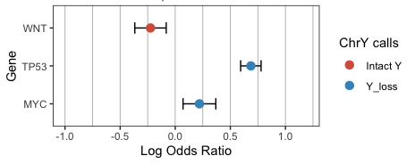
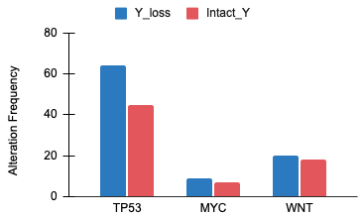
Pathway level differences
Cancer Type
TP53 pathway is positively associated with Y loss
Enriched in Intact Y
Enriched in Y loss
Pancancer
Enriched in Intact Y
Enriched in Y loss
Model: Gene ~ ChrY call + Sample Type + FGA + MSI Type + Cancer Type
Model: Gene ~ ChrY call + Sample Type + FGA + MSI Type
Notes:
Frequency: loss | intact
WNT: 20 | 18 TP53: 65 | 45
MYC: 9 | 7

Slide 14
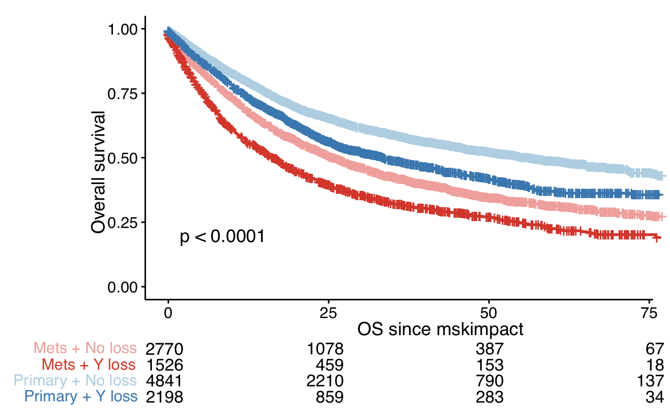
Y loss is associated with shorter overall survival
HR;1.36 , 95CI;1.29-1.44 , P < 2e-16
aHR;1.22 , 95CI; 1.14-1.28, P = 4.84e-11
(adjusted for FGA, MSI Type, Cancer Type, Sample Type)
Notes:
Y loss is associated with shorter overall survival. Patients with chrY loss are 1.2 time more likely to die tahn intact Y samples

Slide 15
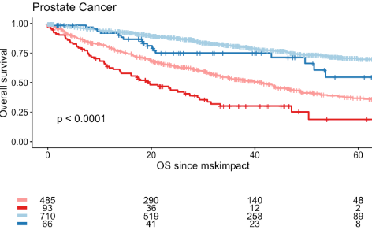
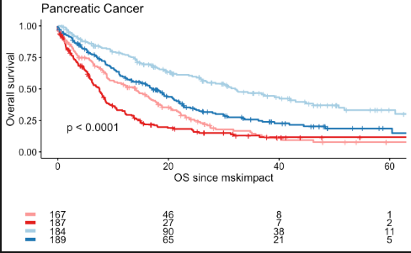
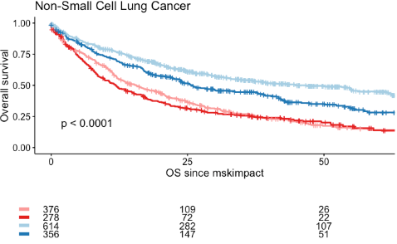
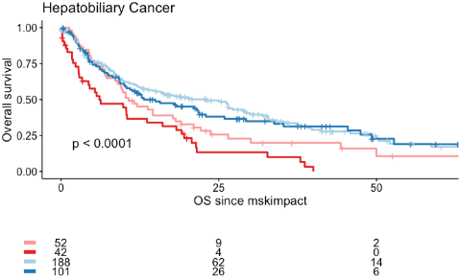
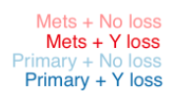
Results: Y loss is associated with shorter OS in Prostate-, Pancreatic-, NSCL-, and Hepatobiliary cancer
Prostate cancer;
HR 1.96, 95CI; 1.53-2.51, P= 6.75e-08
aHR 1.43, 95CI; 1.12-1.85, P =0.0043
Pancreatic;
HR 1.53, 95CI; 1.28-1.82, P = 2.89e-06
aHR 1.50, 95CI; 1.25-1.80, P =8.04e-06
NSCLC;
HR 1.27, 95CI; 1.12-1.44, P =0.0001
aHR 1.19, 95CI; 1.04-1.35, P = 0.009
Adjusted for FGA, MSI Type, Sample Type
Notes:
Y loss is associated with shorter OS in Prostate-, Pancreatic-, NSCL-, and Hepatobiliary cancer

Slide 16
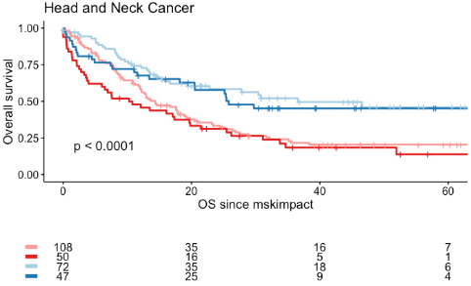
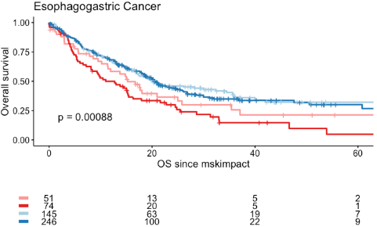
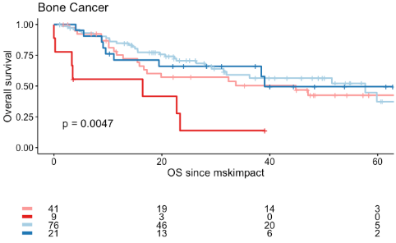
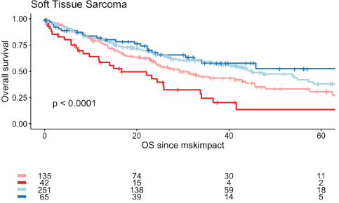

Slide 17
If we want to understand Chr. Y loss dynamics in solid cancer tissue, we need to talk about genetic mosaicism

Slide 18
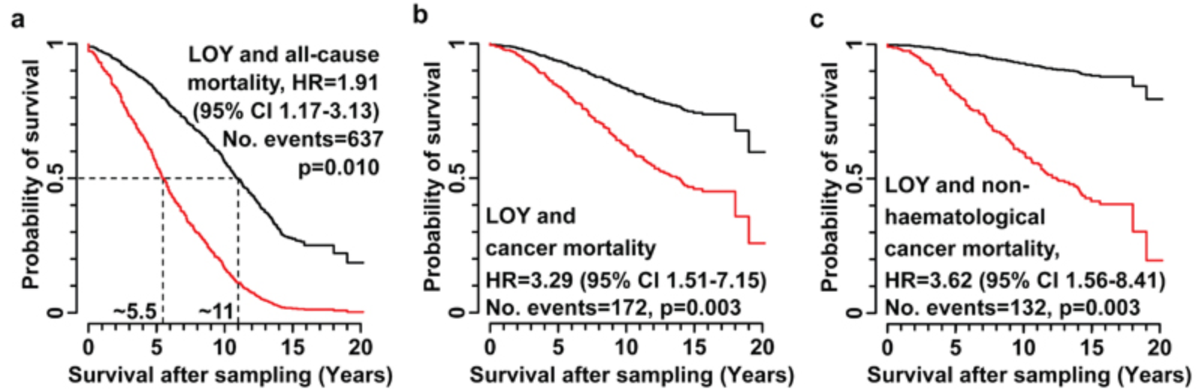
Somatic Mosaicism (Y-chromosome mosaicism)
Introduction II: Mosaicism describes the GERMLINE not the tumor
Genetic variation in chromosome Y is common
most prevalent form is mLOY (increasing with age)
regulates susceptibility to infectious diseases, etc.
Loss of Y chromosome in hematopoietic cells is a positive indicator of cancer in older males
Lars A. Forsberg, et al. Nature 2014

Slide 19
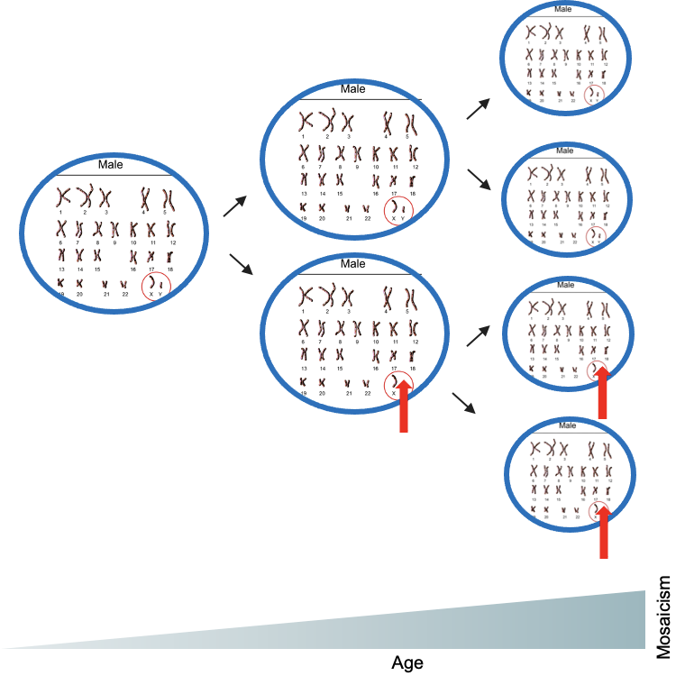
mLOY in aging men has been observed for more than 50y
Introduction III: mLOY can be seen as a quantitative decrease in Y-chromosome DNA content
Again we are talking about germline seq. data (think of blood cells; our ‘normals’)

Slide 20
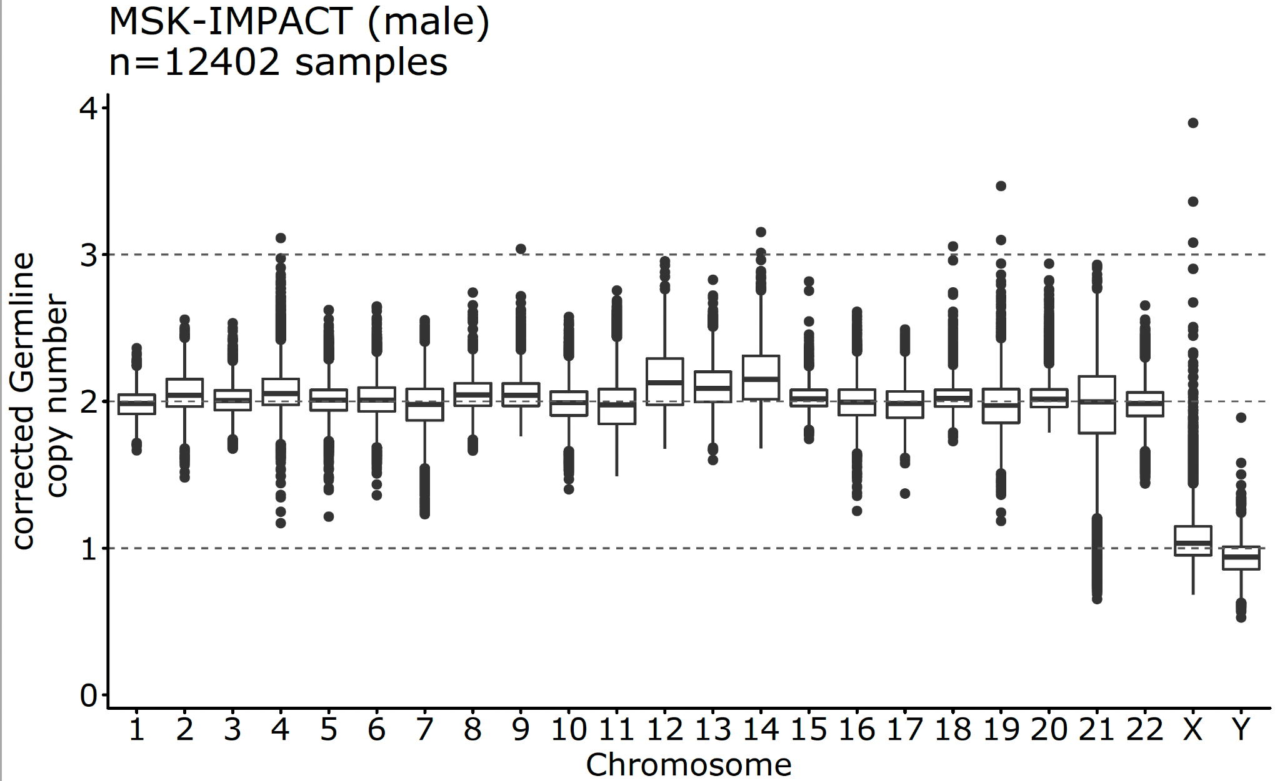
Detection of mLOY works for both, MSK-IMPACT and WES recapture seq. data
Methods: 99% of mLOY detection methods previously relied on Array or ddPCR data
1 kb sliding windows approach
Allosomes / autosomes (read-depth ratio)
GC-bias and peak-correction
*Method established through close exchange with M. Danielsson (Lars Forsberg), Y. Zhao (John Perry), M. Machiela (Chanock Stephen), P. Priestly

Slide 21
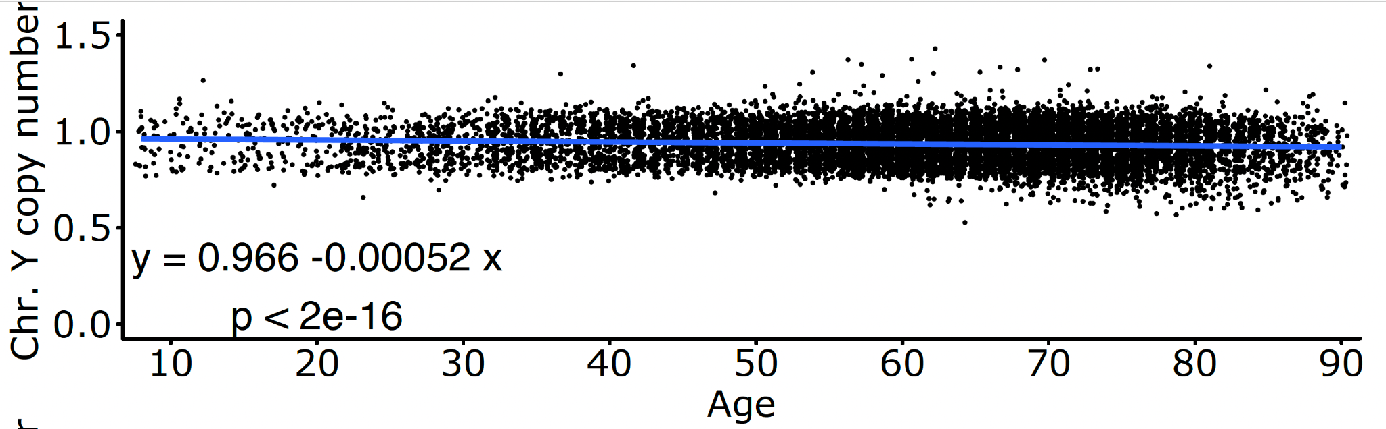
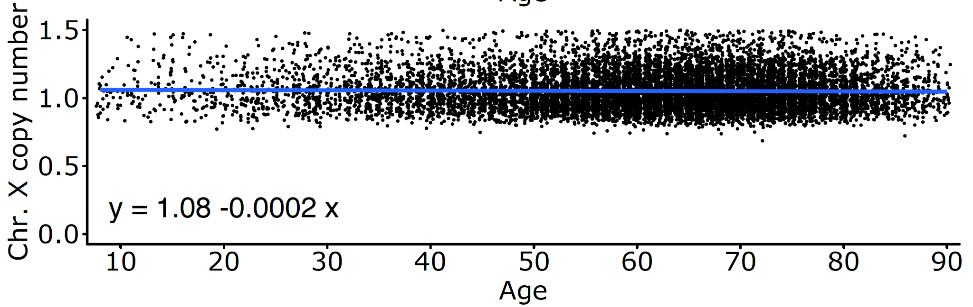
mLOY is associated with age
Results: although the slope has only a minimal decline, it’s significant
slope almost zero

Slide 22
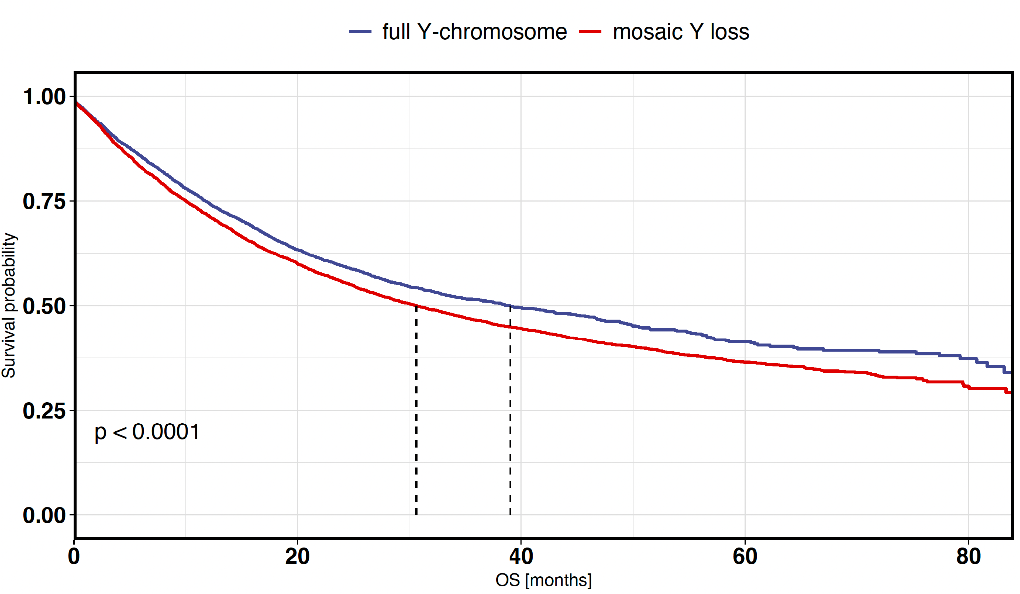
mLOY is associated with an decreased OS
Cancer mortality
HR = 1.14 (95% CI = 1.08-1.21)
Number of events = 5,489; P < 0.001

Slide 23
Why are we including mLOY in our study?
Are mLOY and loss-of-Y chromosome two different entities?
Image, we have a normal (blood, germline) sample with measurable Y-chromosome loss (due to mosaicism, i.e. aging).
We already know that we use T/N ratios to calculate the CN at the Y-chromosome (e.g. solid cancers)
So, if we are observing a Y-chromosome loss in solid cancer tissue,
i) is this on account of mosaicism (unspecific side-effect), OR
ii) do we have any indication that tumorigenesis (specifically) is responsible?

Slide 24
mLOY and Y-chromosome loss are dependent on each other
How to prove that mLOY and loss-of-Y chromosome are independent of each other?
germline
 | No Mosaic | Mosaic
Intact Y-chromosome | 4,155 | 4,019
Y-chromosome loss | 2,128 | 1,833
methodical sound?
cancer tissue
Truly a consequence of tumorigenesis?
Loss due to physiology (age) OR cancer?
Chi-squared p = 0.003

Slide 25
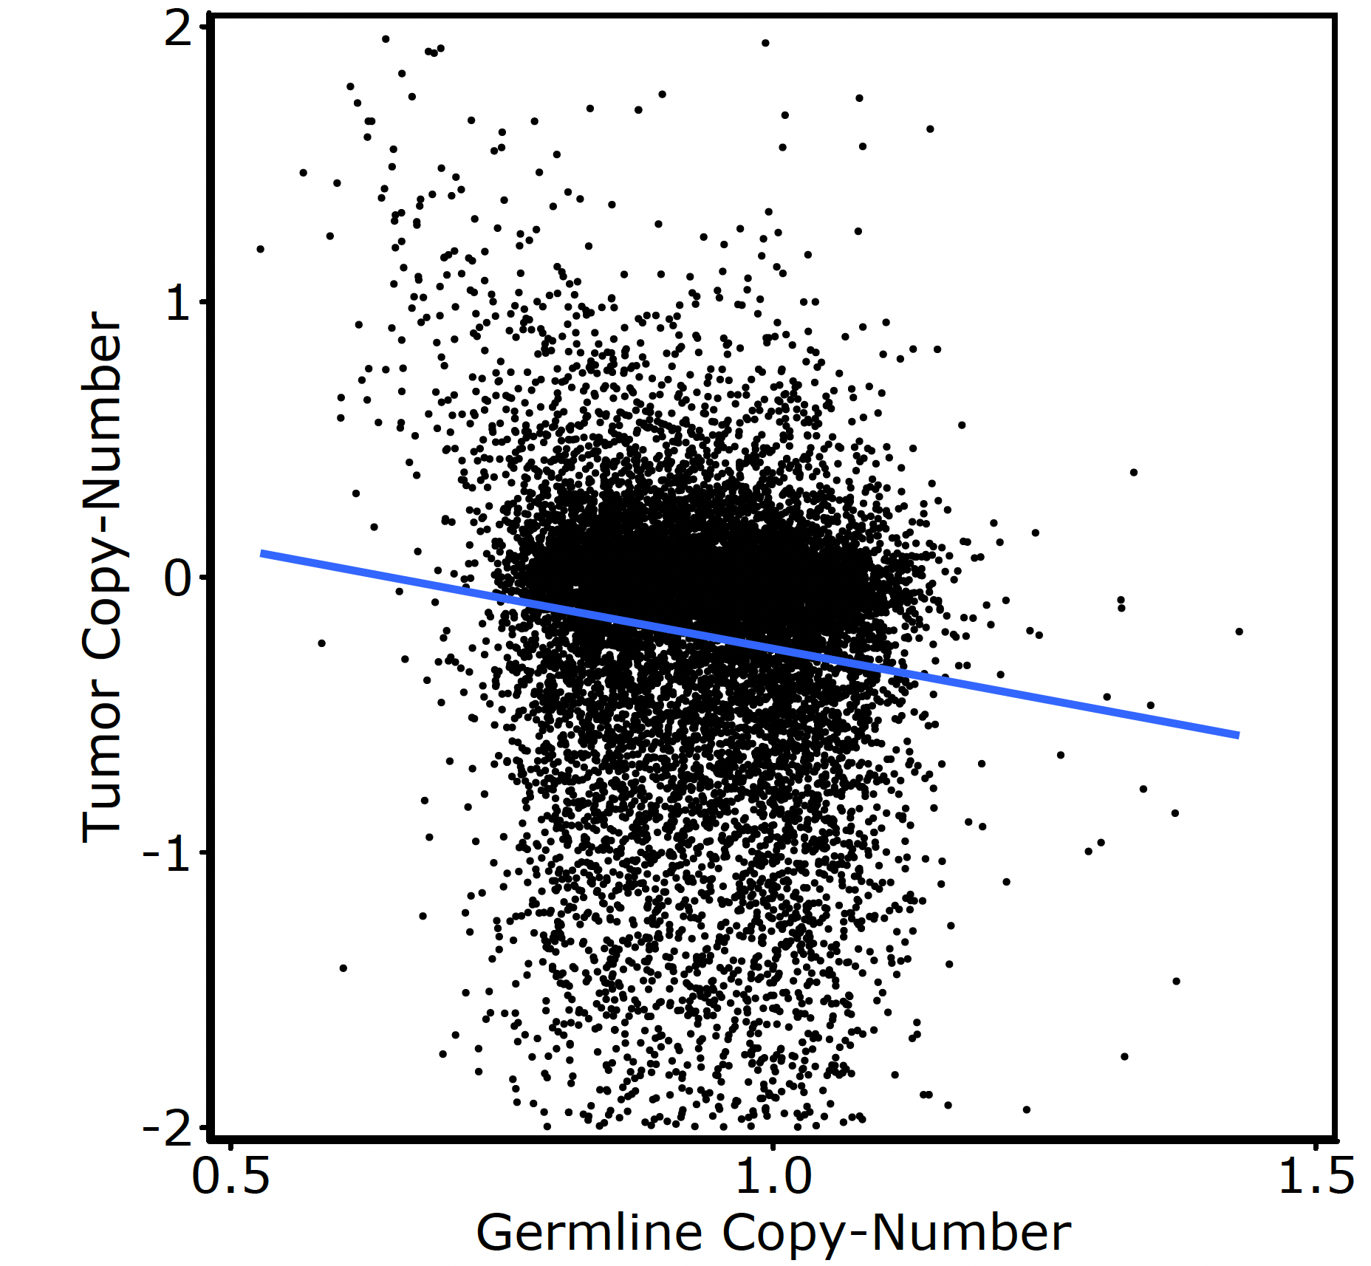
There is no obvious association between Germline and Tumor CN
The dependence shown before does not come from technical bias
r = -0.12
R² = -0.014
Perhaps the dependency arises from age?

Slide 26
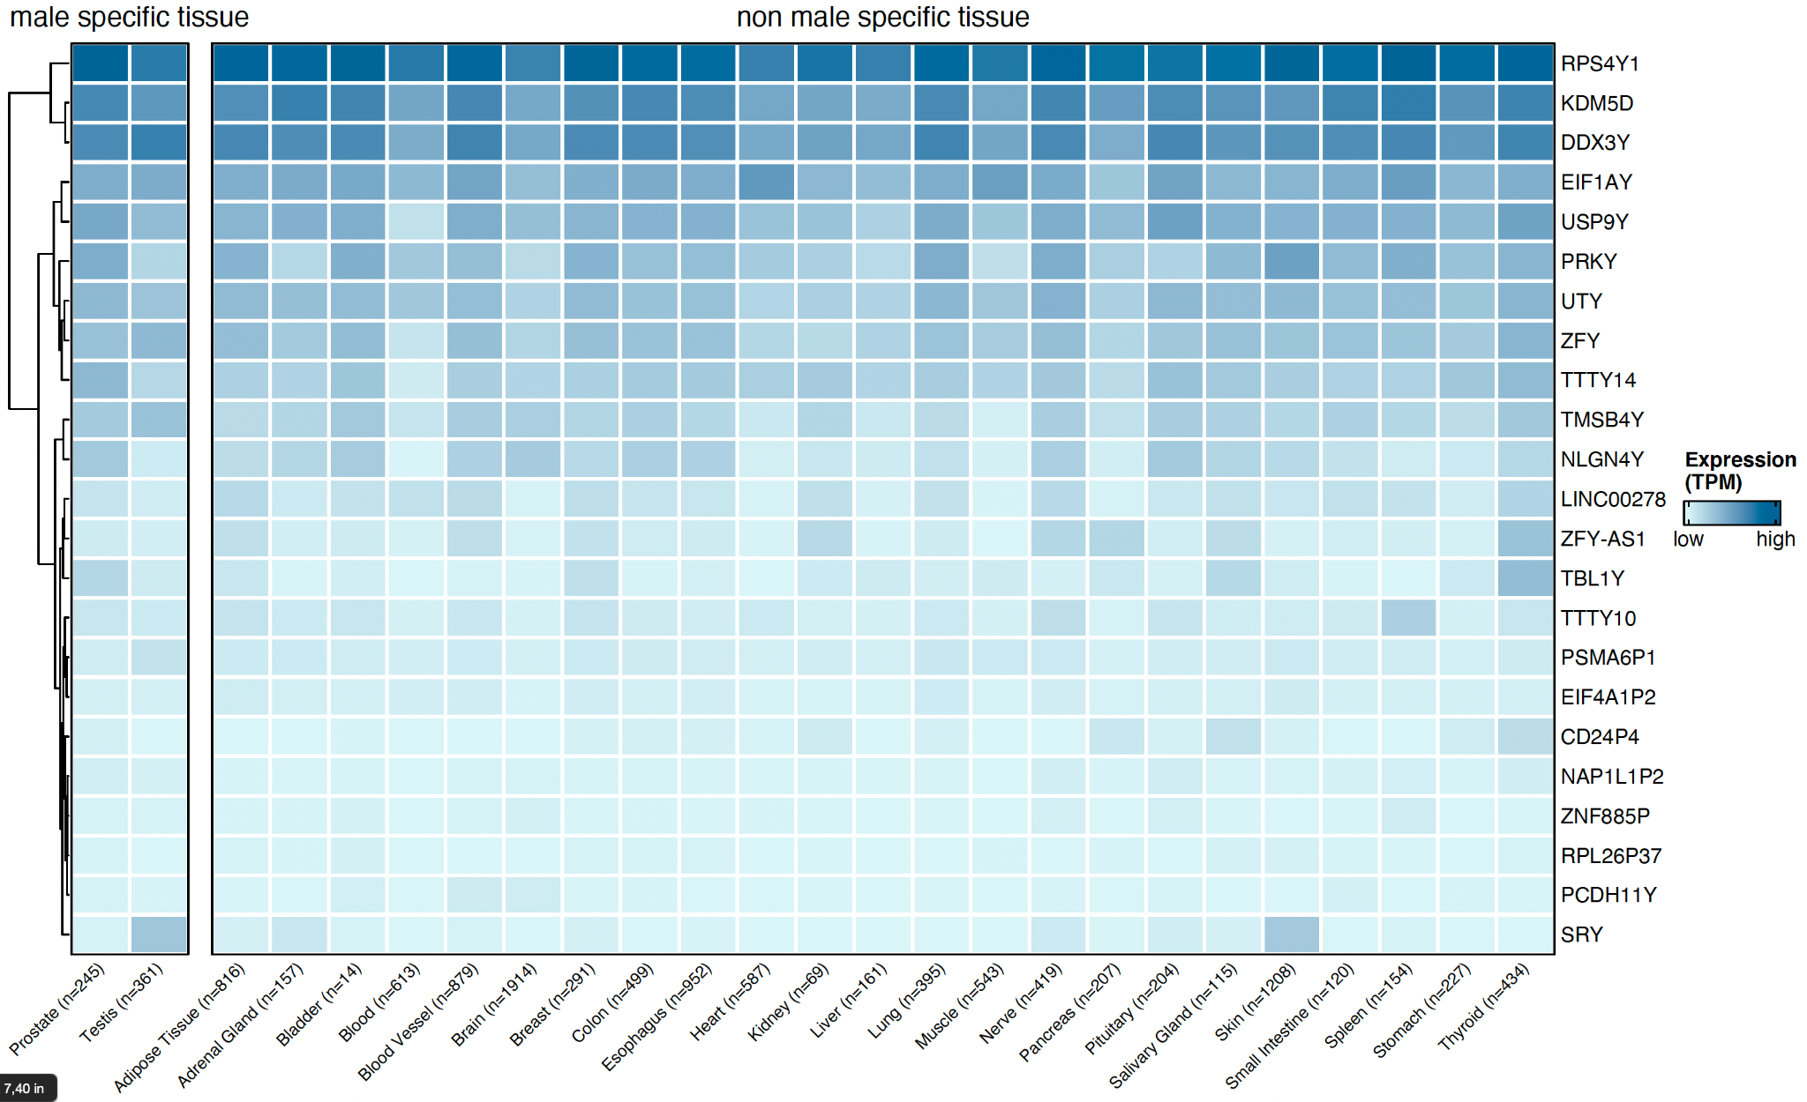
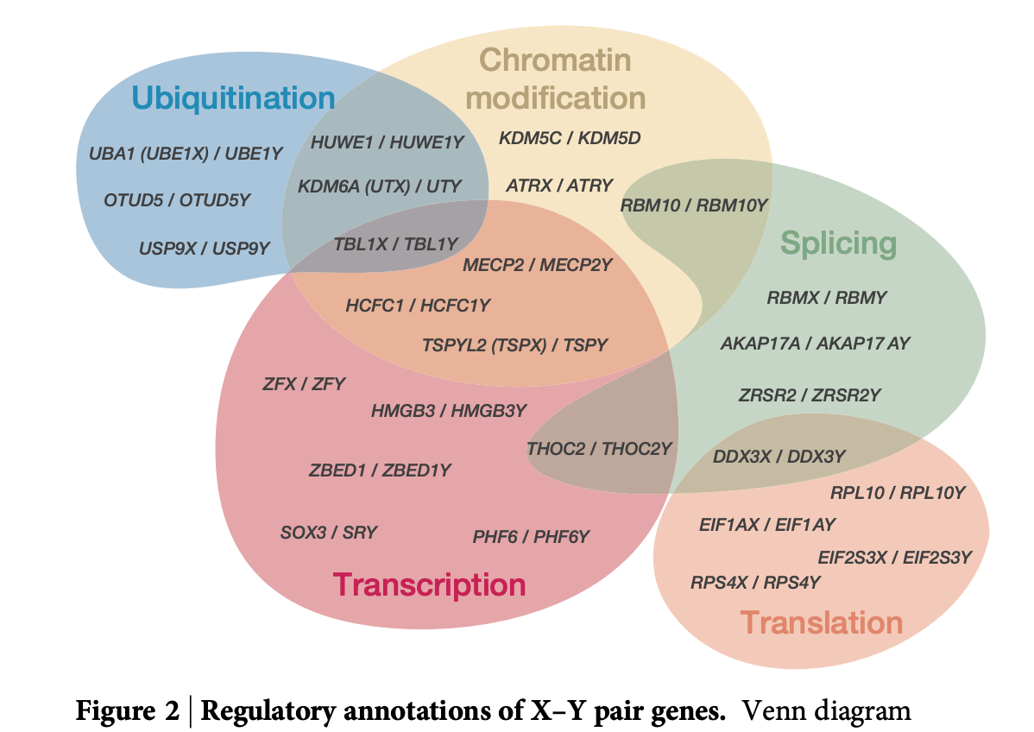
Tumor suppressive function of Y-chromosome?
Assuming mLOY and loss-of-Y are two separate occurrences
Is the Y-chromosome loss a cause (positive selection) or the consequence (CIN) of tumorigenesis?
Y-linked genes are expressed throughout (healthy) tissues
Daniel W. Bellott, et al. Nature 2014

Slide 27
Outlook
Look into specific X-Y gene pairs (e.g. DDX3X/DDX3Y)
Hypothesis: Homologous X-linked genes are buffering deleterious effects of Y-chromosome loss (using WES data)
the human Y-linked genes RPS4Y1 and DDX3Y are functionally interchangeable with their X homologues in vitro*
Co-occurrence pattern (SCNA) of Y-chromosome loss (specific to cancer lineages)
*Watanabe, M., et al. Nature Genet. 1993

Slide 28
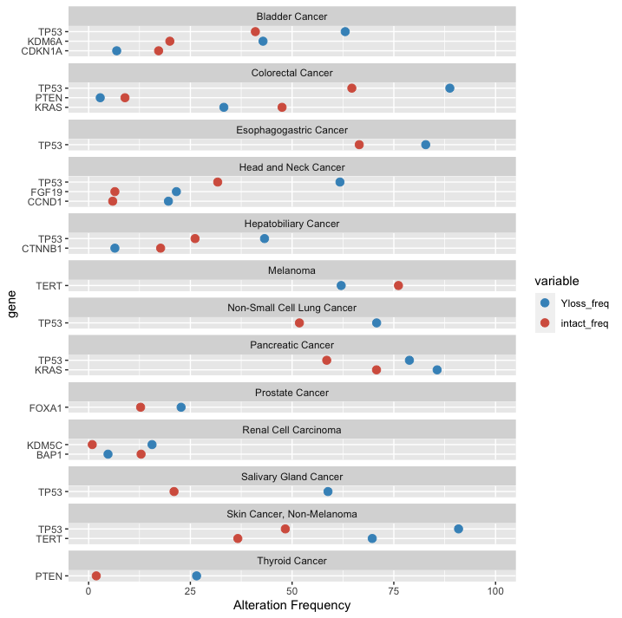
Alteration frequencies of significant gene level enrichments

